Slide 1

Introducing SQL Server 2022
Bob Ward, Principal Architect, Microsoft Azure Data
https://aka.ms/bobwardms

Slide 2

The next step for SQL Server
SQL Server 2016
Query Store
Polybase
Always Encrypted
Row Level Security
It just runs faster
Std Edition surface area
SQL Server 2017
SQL Server on Linux
Containers
Adaptive Query Processing
Automatic Tuning
Graph database
Machine Learning Services
SQL Server 2019
Data virtualization
Intelligent Query Processing
Accelerated Database Recovery
Data classification

Slide 3


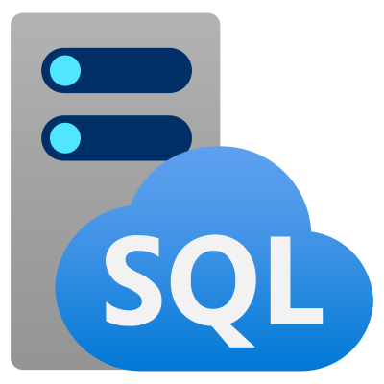




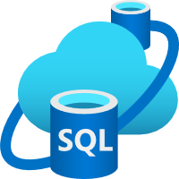


SQL Server 2022 An industry leader in performance and security, powered by Azure
Business continuity through Azure
Seamless analytics over on-prem operational data
Visibility over your entire data estate
Most secure over the last 10 years⁶
Industry-leading performance and availability
Azure Purview
+
Data Insights
Data Catalog
#1 OLTP performance¹
#1 Non-Clustered DW performance on 1TB², 3TB³, 10TB⁴, and 30TB⁵
Data Map
Hero capabilities
Bidirectional HA/DR to Azure SQL
Azure Synapse Link
Azure Purview integration
SQL Server ledger
Built-in query intelligence
Multi-write replication
Most consistent data platform
Edge to Cloud
Azure SQL Edge
Azure Arc-enabled data services
Azure SQL
All TPC Claims as of 10/06/2021.
¹ http://www.tpc.org/4087; ² http://www.tpc.org/3374; ³ http://www.tpc.org/3380; ⁴ http://www.tpc.org/3362; ⁵ http://www.tpc.org/3364; ⁶ National Institute of Standards and Technology Comprehensive Vulnerability Database

Slide 4


When and how
SQL Server 2022 Private Preview
How do I get access?
Limited Private Preview
https://aka.ms/EAPSignup
Intended for customers who will work directly with engineering
Private Microsoft Teams channel and GitHub repo
When will it be generally available?
Public preview in CY 2022
Generally available in CY 2022

Slide 5
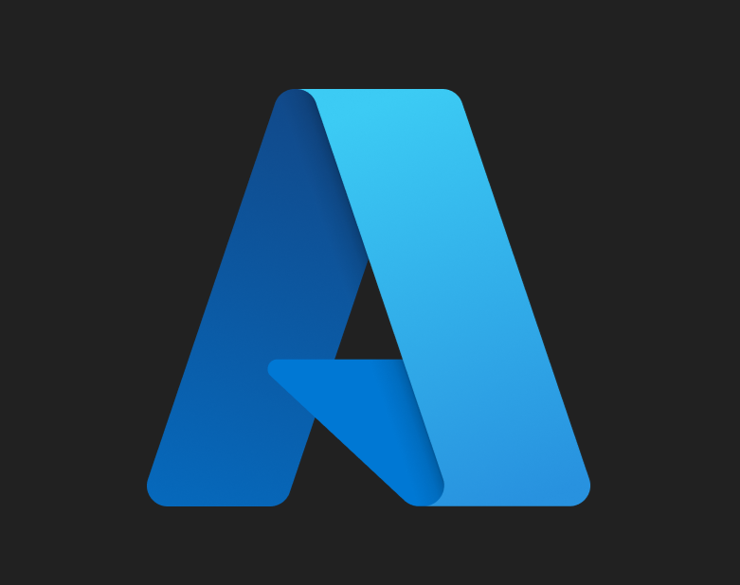





SQL Server 2022 capabilities
Cloud connected
Extending T-SQL
Built-in query intelligence
SQL Server 2022
Data virtualization
Object storage
Security, scalability, availability

Slide 6
Business continuity through Azure SQL Managed Instance Disaster recovery in the cloud with link feature in Azure SQL Managed Instance
Challenge: Difficult to setup and maintain a DR site
Continuously replicate data to and from the cloud
Deploy and configure easily with PaaS
Use Azure SQL Managed Instance for read-scale out
Built-in distributed availability group (DAG)
Restore Azure SQL Managed Instance databases back to SQL Server
Online failover
Azure
DR in the cloud
SQL Server 2022
Azure SQL Managed Instance

Slide 7
Azure SQL Managed Instance for disaster recovery

Slide 8



Azure Synapse Link for SQL Server Seamless analytics over on-prem operational data
Challenge: ETL expensive, out of date,
and affects operational workloads
Store2
Power BI
Break the wall between operational and analytical stores
New change feed capability reduces impact on OLTP workloads
Near real-time latency between SQL Server and Synapse Analytics
Analyze all your data using both Spark and SQL runtimes in Synapse
12
123
Cloud data
IoT data
SaaS data
Azure Synapse Analytics
Azure Machine Learning
Store
Store
ETL
SQL pools
Azure Data Lake Storage
Spark pools
On-premises

Slide 9
Synapse link for SQL Server

Slide 10


Secure your SQL Server 2022 with Azure
Azure Active Directory
Authentication
Azure Purview
Microsoft Defender for SQL

Slide 11
Azure Purview integration Visibility and governance over your entire data estate
Challenge: I need central visibility and
governance across all of SQL
Data Catalog
Automatically scan on-prem SQL Server to capture metadata
Classify data using built-in and custom classifiers and Microsoft Information Protection sensitivity labels
Set up and control specific access rights to SQL Server
Data Map
Data Insights

Slide 12
Azure Purview integration with SQL Server

Slide 13
Query Store and Intelligent Query Processing Accelerate query performance and tuning with no code changes
Challenge: Query tuning is expensive and
time consuming
Intelligent Query Processing (IQP)
Next Generation
Query Store now turned on by default
Query Store support for read replicas from availability groups
Query hints to shape plans with no code changes
New IQP scenarios enabled through better together capabilities
Query Store

Slide 14
Query Store and Intelligent Query Processing Accelerate query performance and tuning with no code changes
Challenge: Query tuning is expensive and
time consuming
Intelligent Query Processing (IQP)
Next Generation
Query Store now turned on by default
Query Store support for read replicas from availability groups
Query hints to shape plans with no code changes
New IQP scenarios enabled through better together capabilities
Max Degree of Parallelism (DOP) feedback
Cardinality Estimation (CE) feedback
Parameter Sensitive Plan (PSP) Optimization
“On” by default
Query Store

Slide 15




Intelligent Query Processing (IQP) NextGen Gain performance with no code changes
cloud first
Upgrade to SQL Server 2022
dbcompat 140+
dbcompat 160
Memory Grant Feedback Percentiles
Smooth out oscillation with percentile-based calculation
Memory Grant Feedback Persistence
Persist feedback on cache eviction
dbcompat 140 = IQP Gen1
dbcompat 150 = IQP Gen1+2
Parameter Sensitive Plan (PSP)
Optimization
Cache multiple query plans for the same parameterized statement
Save the world from parameter sniffing?
Approximate Percentile
Approximate versions for PERCENTILE_CONT and PERCENTILE_DISC
Query Compilation Replay
Persist compile steps
Avoid compile storms
Cardinality Estimation (CE) feedback
Feedback loop for CE model choices and query execution
Use query hints to adjust problems
Query Store
Max Degree of Parallelism (DOP) feedback
Feedback loop for MAXDOP for a specific query
Adjust query MAXDOP without recompilation

Slide 16
Parameter Sensitive Plan Optimization
Before
With PSP optimization
exec myproc 1
exec myproc 1
Seek
Seek
Scan
Scan
Scan
exec myproc 10
exec myproc 10

Slide 17
Parameter Sensitive Plan optimization

Slide 18





Industry-proven database engine Security, scalability, and availability
Secure
Scalable
Available
SQL Server ledger
Always encrypted enhancements
Linux security enhancements
Buffer pool parallel scan
System page latch concurrency enhancements
In-memory OLTP memory enhancements
Multi-write replication with last writer wins
Cross-platform SNAPSHOT backups
Intel QuickAssistTM backup compression

Slide 19
More engine innovations
Crypto enhancements
New granular permissions and roles
Secure encrypted connections
Accelerated Database Recovery perf/scale
XML compression
Shrink database concurrency
Parallel redo enhancements
Improve throughput for DAG
Resumable ADD CONSTRAINT

Slide 20

SQL Server ledger Tamper-evidence track record of data over time
Challenge: I want the power of blockchain
in a centralized system like SQL Server
Bank Regulator
Bank A
Use an encrypted ledger to protect data from tampering and by malicious actors
Built into SQL Server with T-SQL
Establish digital trust in a centralized system using blockchain technology.
Attest to other parties that data integrity has not been compromised
Ledger view
Append-only ledger table
Updatable ledger table
History table
Block N
Block N-1
Block N-2
Trusted storage
Database ledger

Slide 21
SQL Server Ledger

Slide 22



Multi-write replication Multi-master writes for users across multiple locations
Challenge: I need automatic and logical
conflict detection for multi-write replication
SQL Server 2022
Globally distributed database replicas for geo-localized writes
Enhanced conflict detection for inserts and updates with Last Writer Wins (LWW) capabilities
Ensures the last update is persisted across all replicas based on the UTC time of the operation.
T1: Update row 1 set A = 23
T0: Update row 1 set A = 45
Replica 1
Replica 2
Final Value?
A = 45 without LWW (highest replica wins regardless of timing)
A= 23 with LWW (last update wins regardless of replica ID)

Slide 23







Data lake virtualization and object storage Query any data lake and backup/restore SQL to object storage
Challenge: I need to access and use other storage systems
disk
URL
Backup/restore SQL to REST API compatible object storage
PolyBase (REST API)
T-SQL
OPENROWSET or EXTERNAL TABLE
Formats
Parquet, json, csv
Delta
Connectors
s3, ADLS Gen2, Azure Blob Storage

Slide 24
Data Virtualization and Object Storage

Slide 25
Language enhancements for developers Use your T-SQL skills to do more than ever
JSON data
New JSON functions to increase ability to query and manipulate JSON data
Enhanced T-SQL Surface Area
Closing language gaps based on customer feedback and ANSI compatibility
Time Series
Bring Azure SQL Edge support for T-SQL functions to process time series data

Slide 26
Summary
SQL Server 2022 is Azure-enabled for disaster recovery, analytics, and security.
Built-in query intelligence reduces query tuning and gains you performance with no code changes.
SQL Server 2022 has new innovations in security, scalability, and availability
Data virtualization and object storage through standard SQL interfaces.
Extending the T-SQL language for new developer scenarios

Slide 27



Learn more
Learn more about SQL Server 2022
aka.ms/sqlserver2022
Register to apply for the SQL Server 2022 Early Adoption Program and stay informed
aka.ms/EAPSignup
Watch a technical deep-dive on SQL Server 2022
aka.ms/sqlserver2022mechanics
Register for the SQL Server 2022 Webinar
aka.ms/sqlserver2022webinar
Don’t miss us on Data Exposed
aka.ms/dataexposed

